Slide 1

Battle Stakes Tokenomics

Slide 2
Supply and Distribution of $GEN
Initial supply : 200,000 $GEN
$GEN sold in prelaunch : 100,000
Price at prelaunch : $10 USD
Wallets that will interact either BNB or $GEN
Liquidity pool on pancake swap
Treasury
Insurance Fund
Marketing & Development
Stable Coin payout wallet (top 50 daily)
$ARENA Token Fund

Slide 3
Initial $GEN Allocation of 100,000 (not in circulation)

Slide 4
Initial Stable Coin disbursement from presale

Slide 5

Wallets & Functionality
Liquidity Pool
Standard liquidity pool 1 / 1 of $GEN and BNB
Insurance Fund
Provide stability to price. Will have a mechanism like Safuu’s auto liquidity engine but with different time intervals of injection
Blackhole / Fire Pit
This is our burn mechanism. 5% of any $GEN being staked will be sent to be burned at start of battle
Stable Coin Fund
$1,000 in stable coin will be paid out daily to the top 50 leaderboard of wallets (see: Battle Stakes game for more info)
Arena Token Fund
This is the backing for the original 10,000 Arena Tokens that we will introduce in-to the marketplace as rewards for victorious battles
Marketing & Development
Funding for maintenance of protocol, future development of games and additions / utility, and marketing for new users
Treasury
Buybacks, investment into other protocols / business ventures, and price stabilization

Slide 6

Buy Fees
1% - Winner Circles
1% - Arena Token
2 % - Burn
4 % - LP
4 % Insurance Fund
2 % - Treasury

Slide 7

Sell Fees (16%)
1% - Winner Circles
1% - Arena Token
2 % - Burn
4 % - LP
5 % Insurance Fund
3 % - Treasury

Slide 8
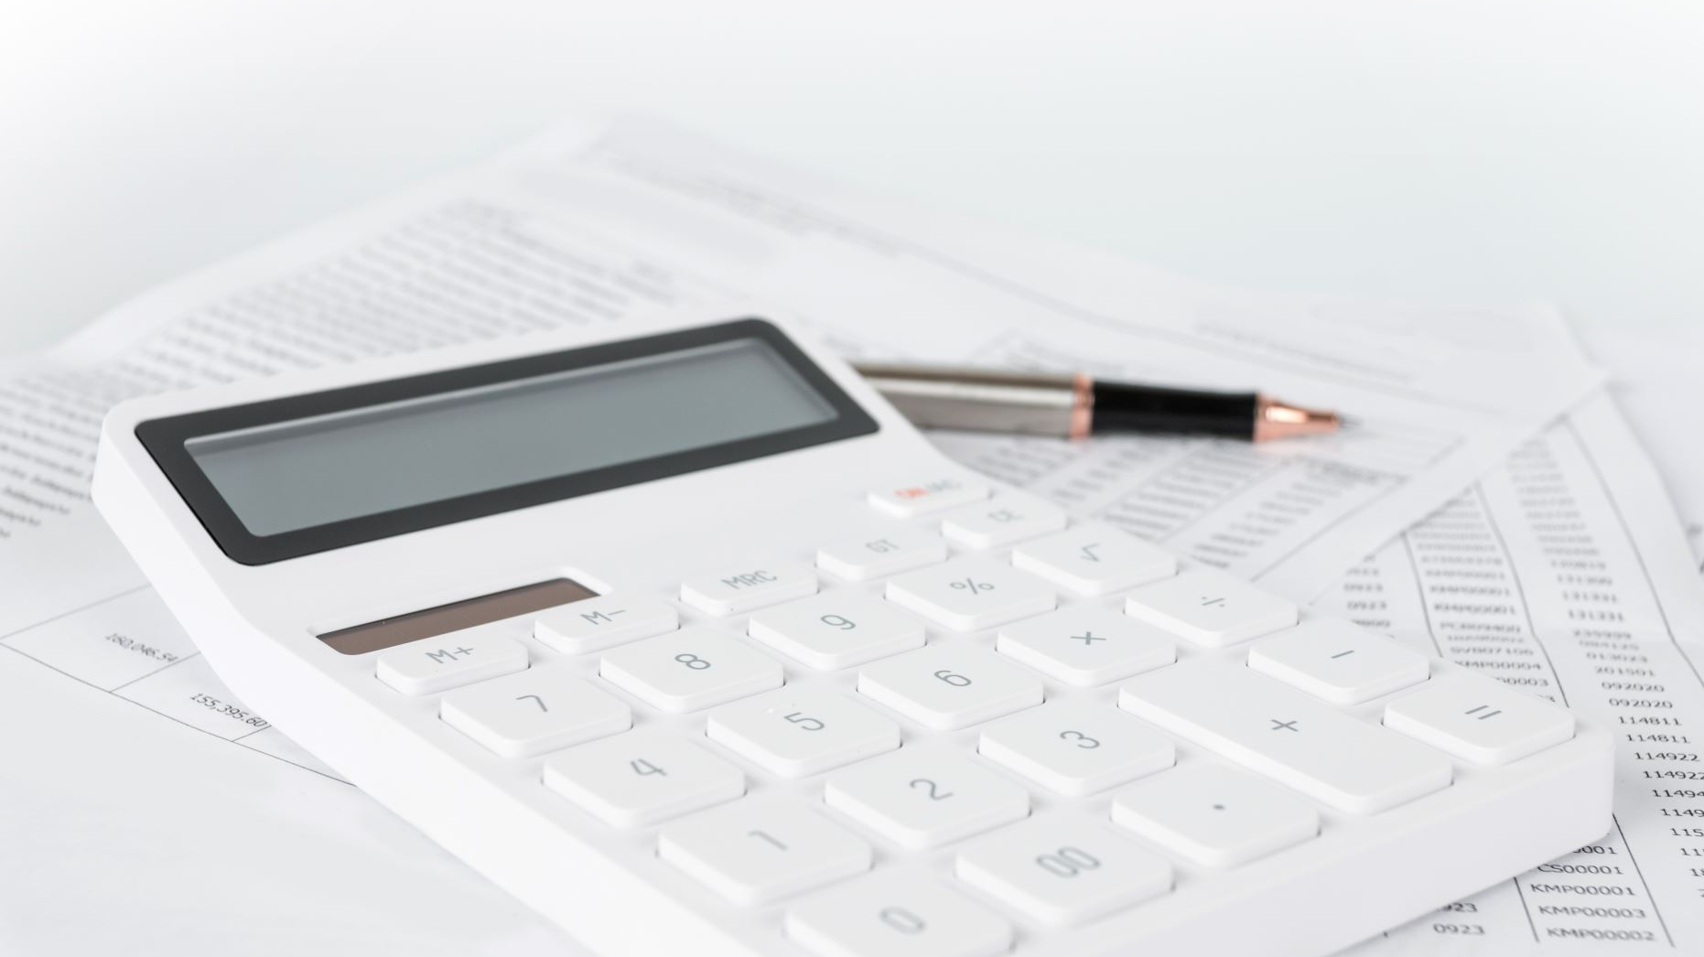
Sell Tax (Additional)
Initially sell tax will be 30%
Every day the tax will drop by 1% until it reaches 16% (in two weeks time)
The additional sell tax surplus is the sell tax minus the standard 16%
(i.e. if it’s day 3 and tax is 28% then the surplus would be 12%: 28-16 =12%)
Surplus will be used towards:
¼ to winners circle fund
¼ to arena token backing value
¼ to liquidity
¼ to dev & marketing

